Slide 1
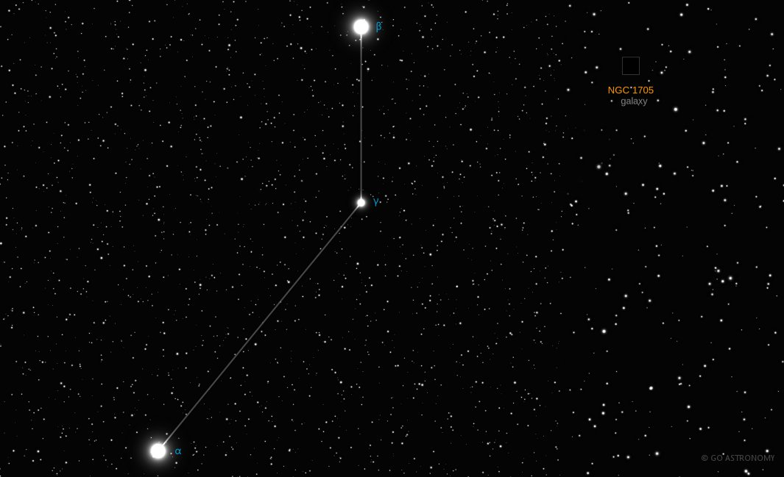
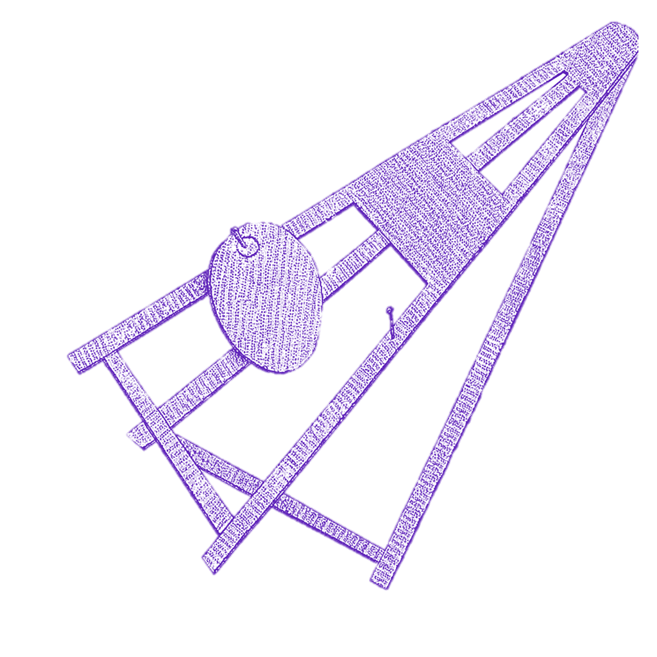
Beta Pic
By Corinne Komlodi

Slide 2
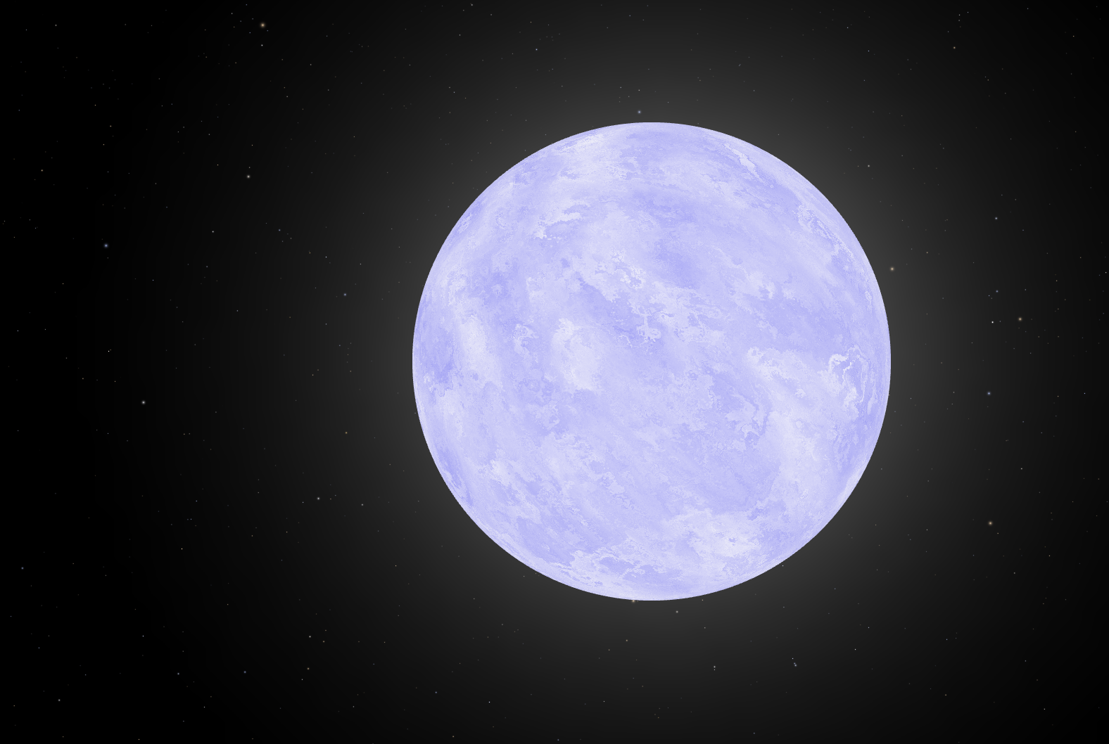
The Star
1.75 Msun
8.7 Lsun
8052 K
20-26 million year old A type star
Part of the Beta Group
Large infrared gas detections
2 planets directly imaged

Slide 3
Direct Imaging Overview
Infrared wavelengths
Photon ratio ~100x vs 10^9x
Planets far from their star
200+ planets found
Limits info to spectrum based calculations
[2]

Slide 4
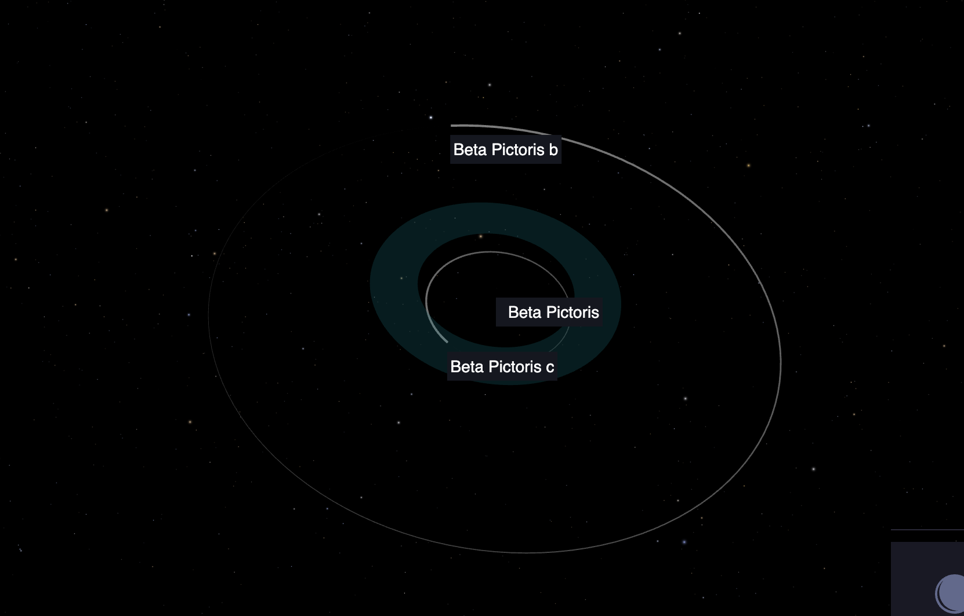
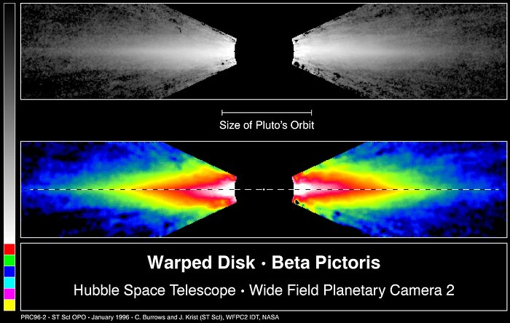
The System
Located 62 light years from Earth
Excess radiation was initially detected by IRAS in 1983
Planet formation is still occurring
Edge on
Slightly tilted disk

Slide 5
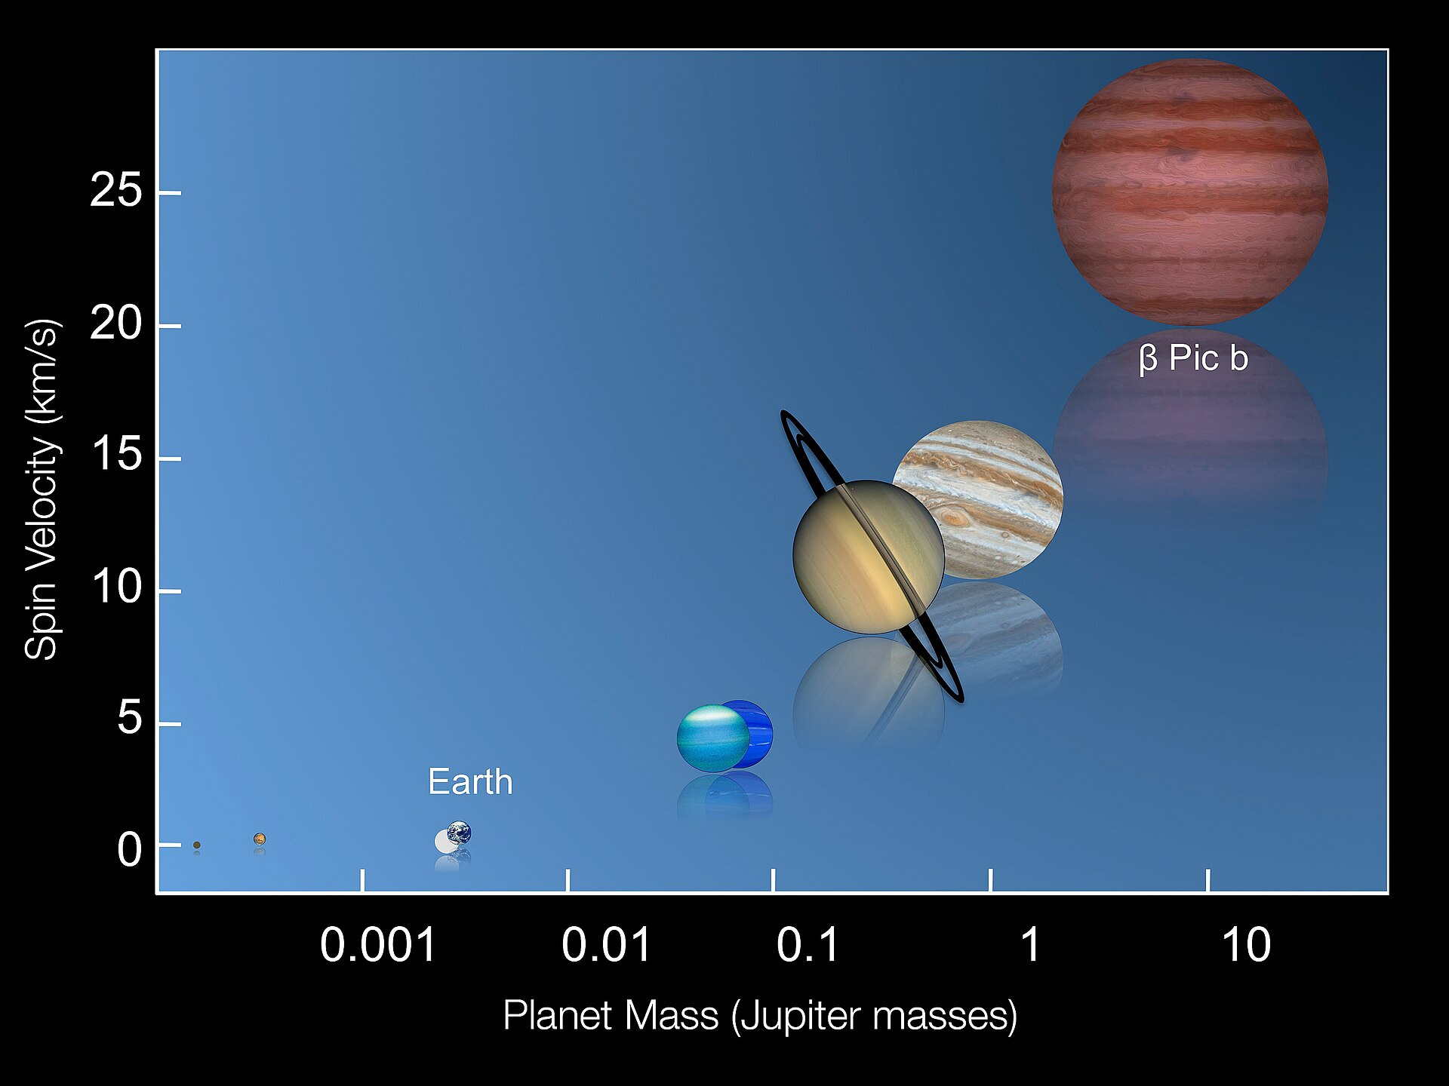
Beta Pic b
November 18, 2008 by Anne-Marie Lagrange et al
VLT
9 AU away from its star
4 directly imaged exoplanets
13 Jupiter Masses
Period of 20-21 years
46% larger than RJupiter
As of 2015 it was the first and only planet to have its rotation rate measures (8.1 hours)

Slide 6
Beta Pic c
Indirectly through 10 years of observation
HARPS spectrascope
2.7 AU away from its star
Initially RV, then direct image
10 Jupiter Masses
Period of 3.3 years
1.2% larger than RJupiter
Unknown rotational period
Part of the orbit is within BP’s habitable zone

Slide 7

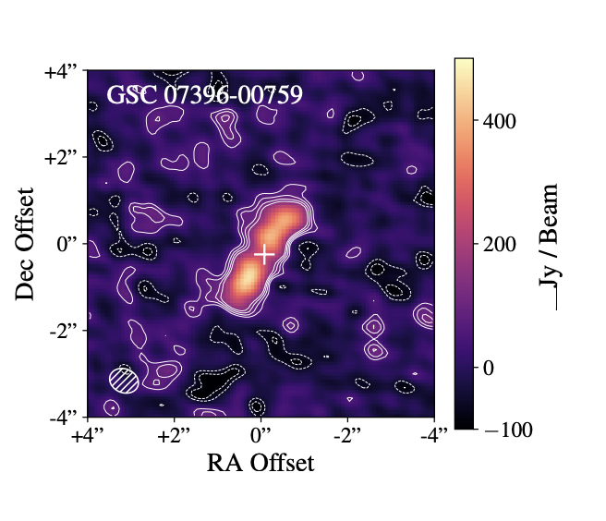
By observing other stars in the beta pic moving group, disks can be resolved around M-dwarfs
This paper finds 37 of such disks
Concludes that they are just as frequent as G and K type dwarfs
Must be observed at longer wavelengths

Slide 8
References
[1 ]https://en.wikipedia.org/wiki/Beta_Pictoris
[2] By Jason Wang (Caltech)/Gemini Planet Imager Exoplanet Survey - https://jasonwang.space/orbits.html (image link), CC BY 4.0, https://commons.wikimedia.org/w/index.php?curid=90908880
[3] https://esahubble.org/images/opo9602a/
[4] https://en.wikipedia.org/wiki/Beta_Pictoris_c
[5] https://lco.global/spacebook/exoplanets/direct-imaging/#:~:text=Over%20200%20planets%20have%20been,times%20brighter%20at%20visual%20wavelengths.
[6] Cronin-Coltsman et al.

